Slide 1


Customer Data Analysis
Using PowerBi
Submitted by: Team ID: PTID-CDA-JUL-26-11142
Adarsh Keerthi
Harsh Raj Singh

Slide 2


Project Overview
This project analyzes customer data for shopping using Power BI to identify purchasing behavior, customer demographics, and sales trends. The project involves data cleaning, transformation, visualization, and dashboard development to generate meaningful business insights and support data-driven decision-making.
Data Collection
↓
Data Cleaning
↓
Data Transformation
↓ Dashboard Creation
↓ Business Insights
↓ Recommendations
Scope of the Project
Add The scope of this project is to analyze customer shopping behavior using Power BI by examining purchasing patterns across different customer segments. The analysis focuses on understanding shopping trends based on gender and age groups, evaluating the performance of various product categories, and studying customer payment preferences.
An interactive Power BI dashboard has been developed to visualize the findings effectively, enabling better interpretation of the data. Based on the analysis, meaningful business
insights and strategic recommendations are provided to support informed decision-making and improve overall business performance.

Slide 3


Dataset Overview
Dataset Description
The dataset contains customer shopping transaction records collected from multiple shopping malls. Each record includes customer demographics, product details, purchase information, payment methods, and shopping locations. This dataset is used to analyze customer purchasing behavior, sales performance, and revenue trends using Power BI.
Dataset Attributes
Field | Description
Customer ID | Unique customer identifier
Invoice Number | Unique invoice for each transaction
Gender | Male / Female
Age | Customer age
Category | Product category purchased
Quantity | Number of items purchased
Price | Price of the purchased items
Payment Method | Cash, Credit Card, or Debit Card
Invoice Date | Date of purchase
Shopping Mall | Shopping mall where the purchase was made

Slide 4



Data Preparation
Data Cleaning & Transformation
The dataset was prepared in Power BI before creating the dashboard. The following preprocessing steps were performed:
Imported the CSV dataset into Power BI. Verified and corrected data types for all fields.
Created a Revenue calculated column (Quantity × Price). Created an Age Group column for customer segmentation. Checked the dataset for missing or inconsistent values.
Built an interactive dashboard with relevant visualizations.

Slide 5

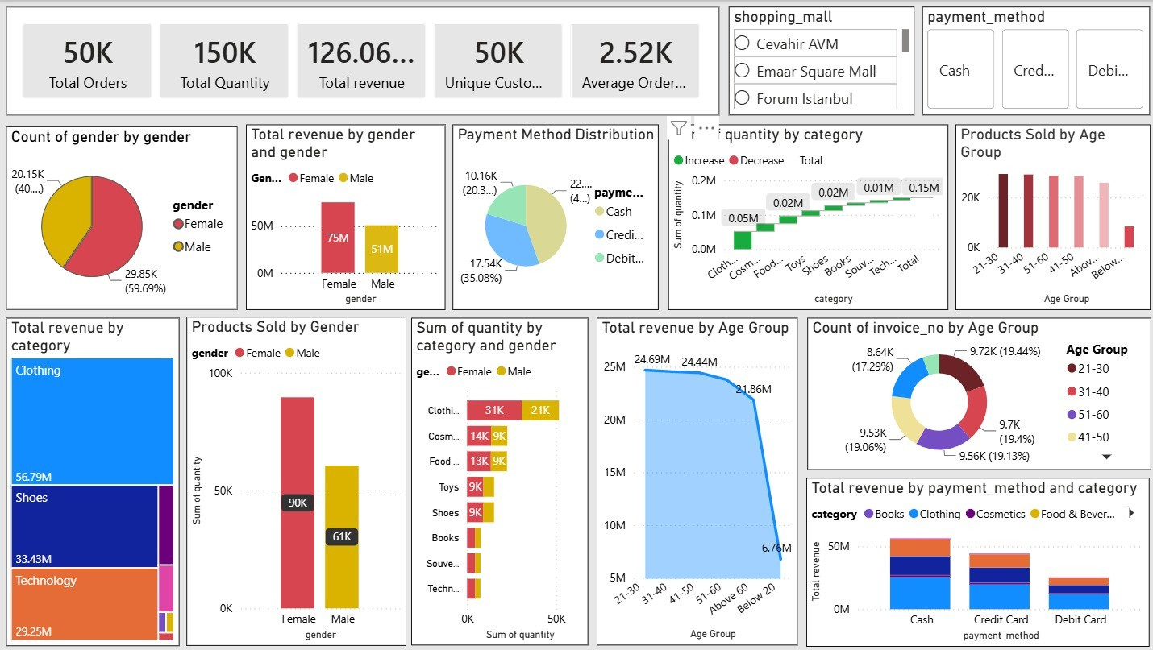
Customer Purchase Analysis
Observation
Total Orders: 50K Total Quantity Sold:
Total Revenue: 126.06M Unique Customers: 50K Average Order Value: 2.52K
Interactive filters: Shopping Mall & Payment Method
Business Insight
The dashboard provides a comprehensive overview of the overall business performance, helping stakeholders monitor revenue, customer behaviour, product sales, and business growth across the complete dataset.
Female customers contributed overall revenue than male customers.
Clothing emerged as the highest-performing product category in terms of sales.
The 21–40 age group contributed the highest number of purchases.
Cash was the most preferred payment method across customers.
Recommendation
The company should regularly monitor overall KPIs to support strategic planning, improve sales performance, and make data-driven business decisions.

Slide 6
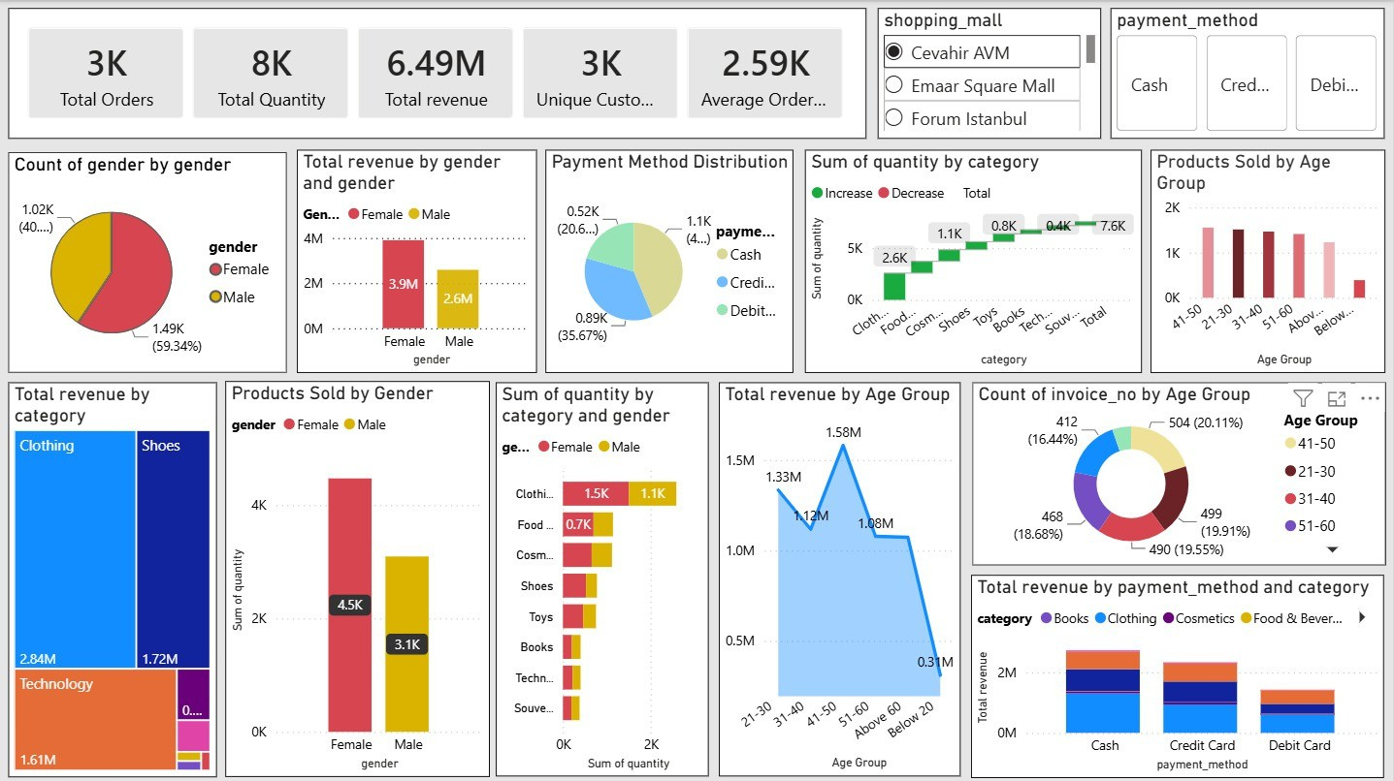
Interactive Dashboard Analysis
Observation:
The dashboard displays filtered results based on the selected Shopping Mall and Payment Method.
After applying filters, the dashboard shows 3K orders, 8K products sold, and ₹6.49M revenue.
All KPIs and charts update dynamically according to the selected filters.
Business Insight:
The interactive dashboard enables users to analyze specific business segments instead of the entire dataset. By applying filters, decision-makers can compare shopping malls, evaluate payment methods, identify location-specific customer behaviour, and uncover targeted sales opportunities.

Slide 7

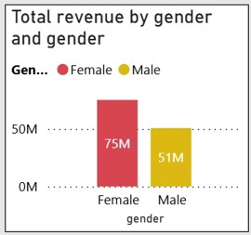
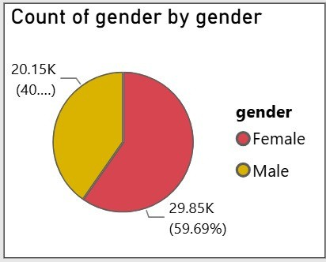
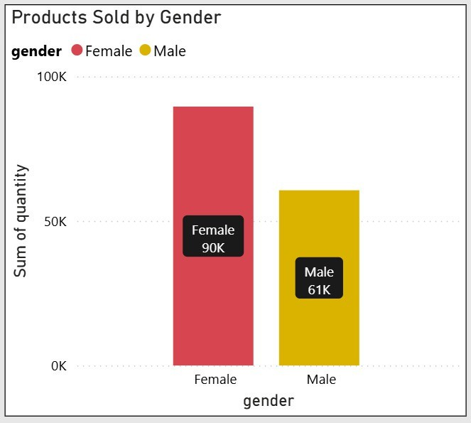
Gender Analysis
📌 Observation:
Female customers represent ~60% of customers. Female customers generated ₹75M revenue.
Female customers purchased 90K products.
💡 Business Insight:
Female customers are the primary contributors to sales and overall business revenue.
✅ Recommendation:
Launch loyalty programs for female customers and create targeted campaigns to increase male customer engagement.

Slide 8

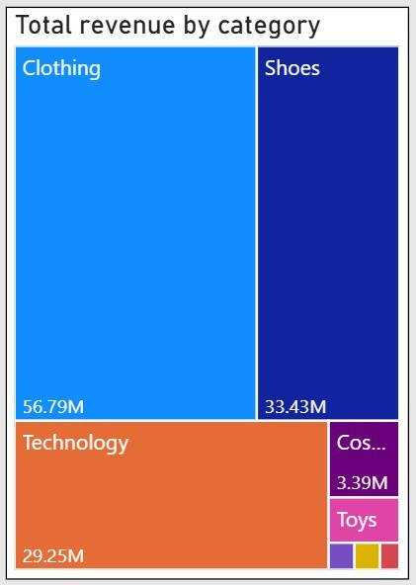
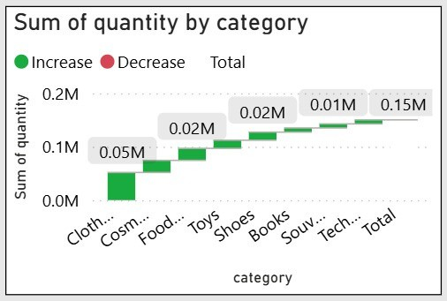

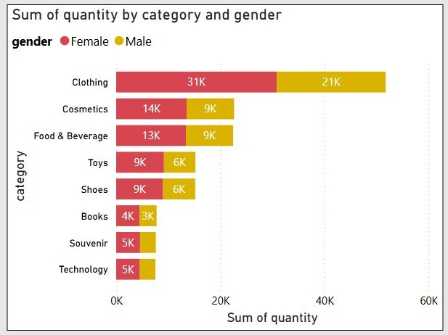
Sales Performance Analysis
📌 Observation:
Clothing generated the highest revenue among all product categories.
Clothing also recorded the highest number of products
sold, making it the best-performing category.
Female customers purchased more products than male customers across most categories, particularly in Clothing and Cosmetics.
Categories such as Books and Souvenirs contributed comparatively lower sales and revenue.
💡 Business Insight:
Product category has a significant impact on overall sales performance. Clothing is the primary revenue driver, while customer purchasing preferences differ by gender. Understanding these patterns helps businesses optimize inventory, improve product assortment, and develop targeted marketing strategies.
🎯 Recommendation:
Maintain adequate inventory for high-demand categories such as Clothing and Shoes.
Introduce promotional campaigns for lower-performing
categories like Books and Souvenirs.
Use gender-specific marketing campaigns to promote products based on customer purchasing behavior.
Continuously monitor category-wise sales trends to improve product planning and maximize revenue.

Slide 9

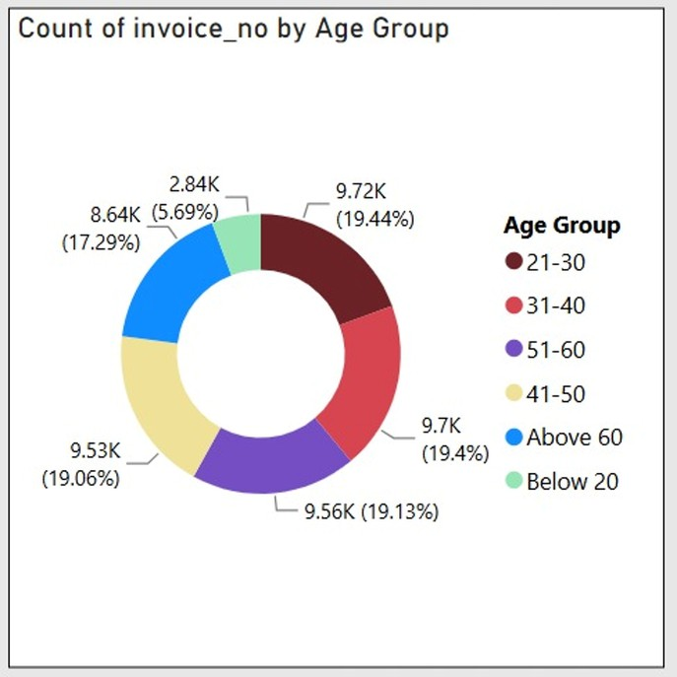
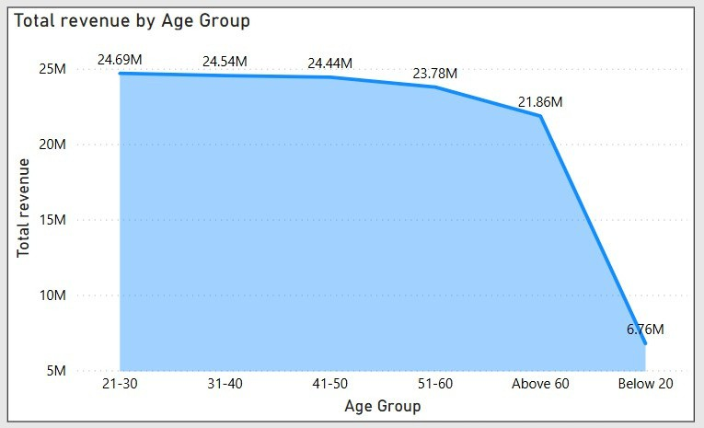
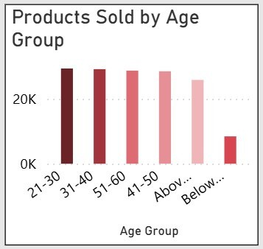
Observation:
The 21-30 age group generated the highest total revenue among all age groups.
Age group Analysis
The 21-30 age group recorded the highest number of customer orders (9.72K), indicating the highest shopping frequency.
The 21-30 age group also purchased the highest quantity of products, making it the most active customer segment.
Sales and customer activity gradually decrease across the remaining age groups.
Business Insight:
Customers aged 21–30 represent the company's primary customer segment. Their higher purchasing frequency, greater product demand, and stronger revenue contribution indicate that they play a crucial
role in overall business performance and long-term growth.

Slide 10

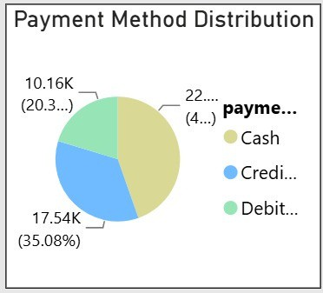
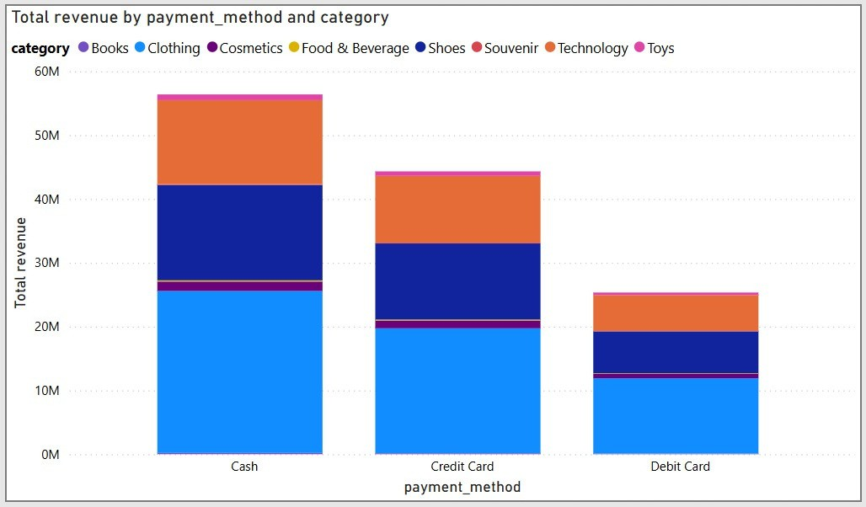
Payment Method Analysis
📊 Observation
Cash generated the highest revenue among all payment methods. Cash was the most frequently used payment method by customers.
Credit Card and Debit Card were also commonly used, but their contribution was lower than Cash.
Customer payment preferences vary, indicating multiple payment options are actively used.
💡 Business Insight:
The analysis indicates that Cash is the preferred payment method, contributing the highest revenue and transaction volume. At the same time, customers also use digital payment options, highlighting the importance of offering multiple secure and convenient payment methods to meet different customer preferences.

Slide 11
Key Business Insights
Shopping mall performance varied, indicating that some locations generated higher revenue and customer traffic than others.
The dashboard provides valuable insights into customer behaviour, sales performance, and purchasing trends, enabling data-driven business decisions.
Shopping mall performance varied, indicating that some locations generated higher revenue and customer traffic than others.
The dashboard provides valuable insights into customer behaviour, sales performance, and purchasing trends, enabling data-driven business decisions.
Female customers contributed a larger share of overall revenue and purchased more products than male customers.
Clothing emerged as the highest-performing product category in terms of both revenue and quantity sold.
The highest-performing age group (apne dashboard ke hisaab se, jaise 21–30 ya 31–40) generated the maximum revenue and placed the highest number of orders.
Cash was the most preferred payment method, contributing significantly to total sales.

Slide 12


Strategic Recommendations
Based on the data analysis findings, the following strategic actions are recommended to improve business performance and customer satisfaction:
Focus on High-Value Customers: Strengthen customer retention by introducing loyalty programs and personalized offers for customer segments that contribute the highest revenue.
Optimize Product Management: Maintain sufficient inventory for high-demand product categories and implement promotional campaigns to improve the sales of lower-performing categories.
Target the Most Active Age Group: Develop age-specific marketing campaigns and promotional offers to increase customer engagement and encourage repeat purchases.
Enhance Payment Experience: Encourage the adoption of digital payment methods by offering cashback, discounts, and reward programs while continuing to support customers' preferred payment options.
Improve Shopping Mall Performance: Analyze sales performance across different shopping malls and implement location-specific marketing strategies to increase revenue in lower-performing locations.
Support Data-Driven Decision Making: Regularly monitor business KPIs and customer purchasing trends using Power BI dashboards to identify opportunities, track performance, and support strategic business decisions.

Slide 13


CONCLUSION
This project successfully analyzed customer purchasing behavior using Power BI by examining key factors such as gender, age group, product categories, payment methods, and shopping mall performance. Interactive dashboards and visualizations helped identify sales trends, customer preferences, and revenue patterns across the dataset. The insights derived from the analysis support data-driven decision-making and provide valuable recommendations for improving marketing strategies, inventory management, and overall business performance. Overall, the project demonstrates how business intelligence tools can transform raw data into meaningful insights for strategic planning.

Slide 14
Thank You

